Slide 2
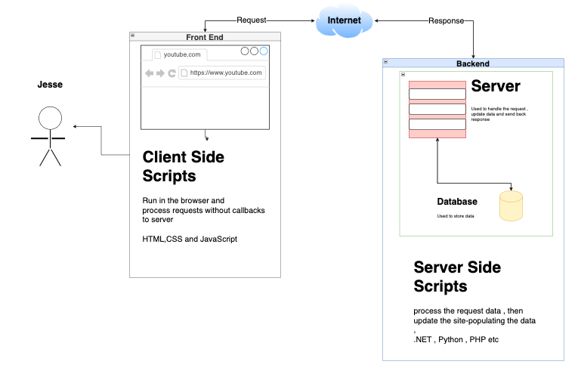
WHAT Is BACKEND?

Slide 3
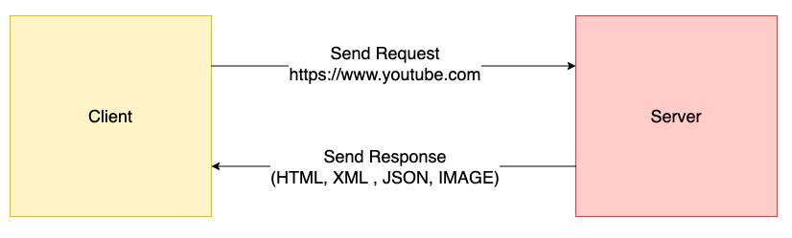
CLIENT SERVER

Slide 4
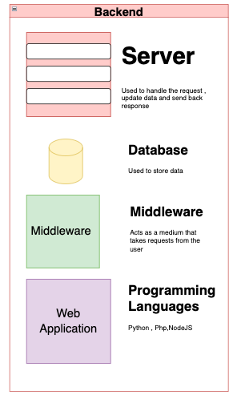
Backend components

Slide 5
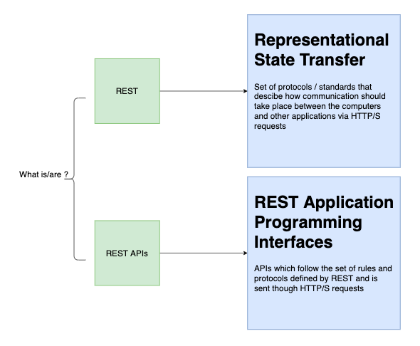
What is REST

Slide 6
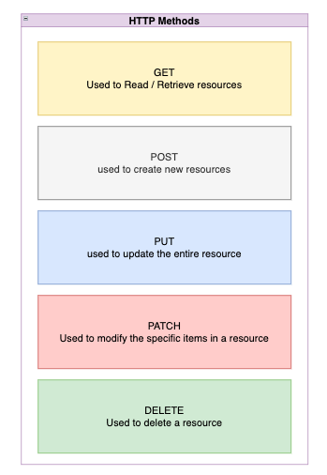
HTTP METHODS

Slide 7
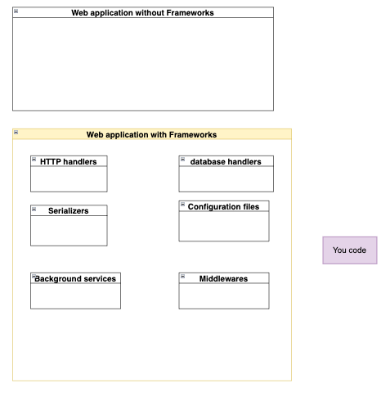
Frameworks

Slide 8
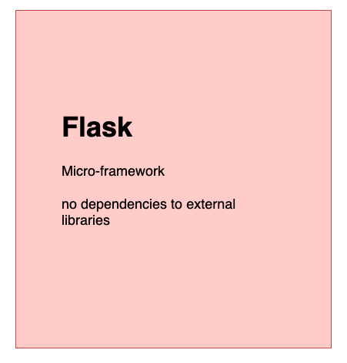
WHY FLASK?

Slide 9
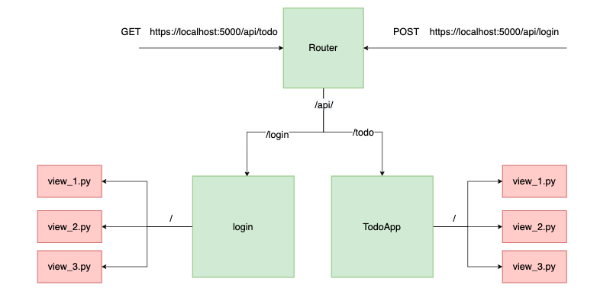
PROCESS FLOW IN FLASK

Slide 10
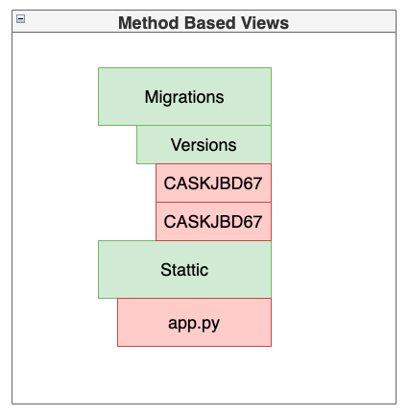
METHOD BASED VIEWS

Slide 11
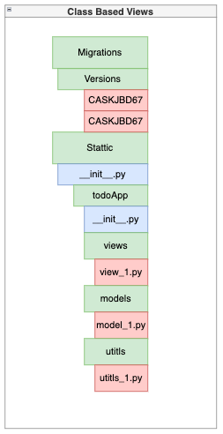
CLASS BASED VIEWS

